Slide 1
My Gymnastics Activity Book
Your Name

Slide 2
My Daily Gymnastics Challenges
Challenge | Mon | Tues | Weds | Thurs | Fri | Sat | Sun
Week 1
Week 2
Week 3
Week 4
Week 5
Week 6
Follow us on social media to find our daily challenges

Slide 3
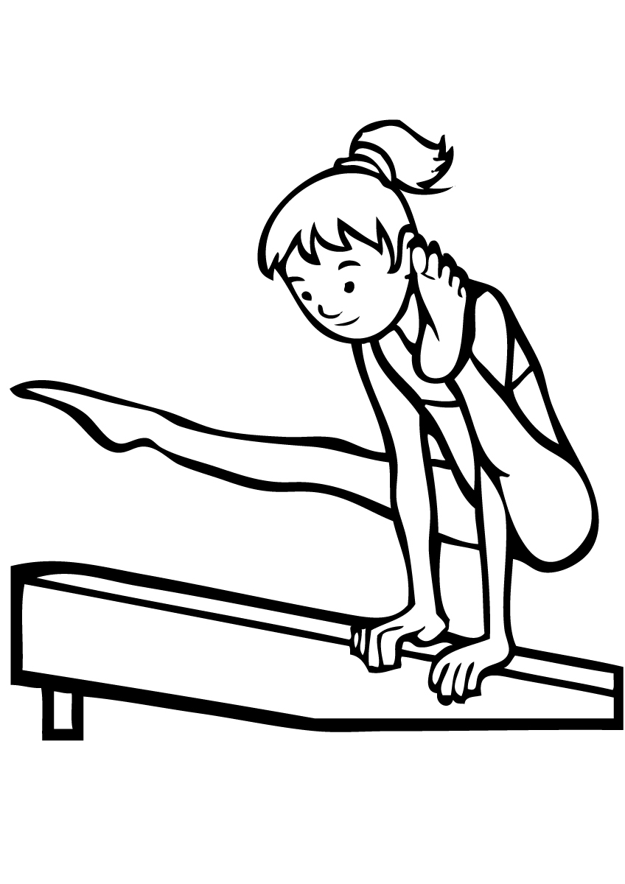
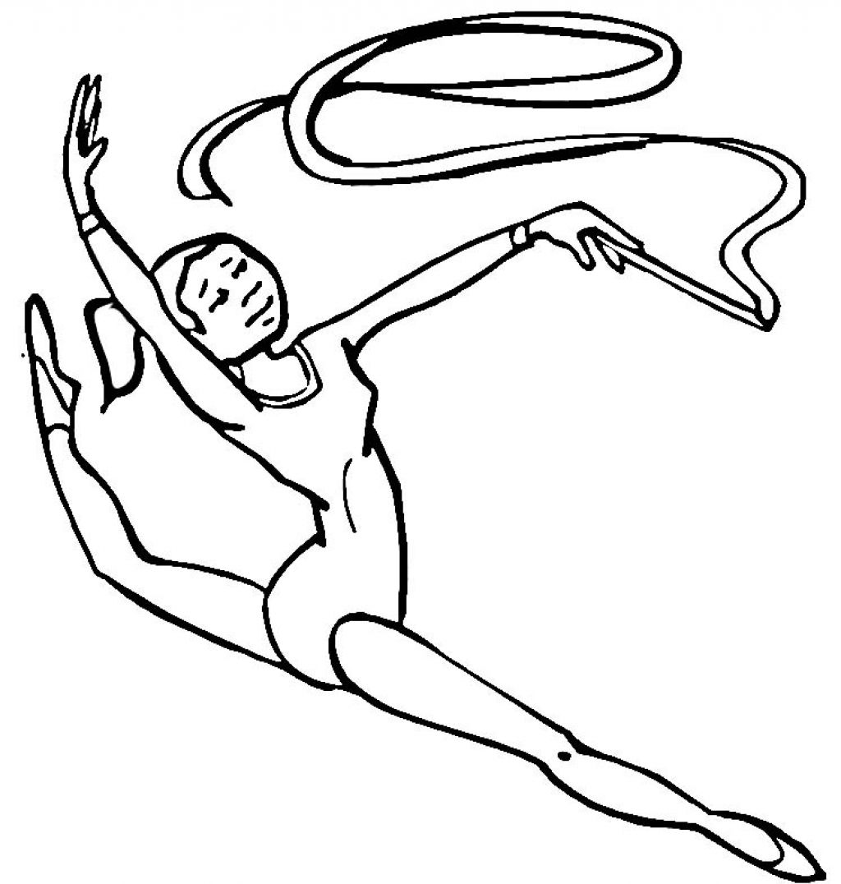
Colouring challenge!

Slide 4
Who does it better?
Take a picture of yourself doing one of our “Grown-ups vs Kids” exercises and pop your pictures on the slide below
Kid
Grown Up
Follow us on social media to find our Grown-ups vs Kids Challenges

Slide 5

Wordsearch Fun – Level 1
A | E | O | W | C | F | F | V | G | B | H | J | I | S | D | Z
M | J | A | S | E | B | T | E | B | E | T | J | S | D | L | R
H | F | G | A | Z | A | U | S | B | I | C | A | D | E | Y | N
T | L | K | V | E | R | G | P | R | W | H | B | W | S | M | E
E | O | E | B | I | S | P | L | I | T | S | Y | M | H | V | T
X | O | J | E | C | Q | J | Q | D | O | O | G | F | O | Z | N
L | R | N | B | E | A | M | T | G | A | B | Q | C | W | A | Y
G | R | E | K | O | F | I | U | E | S | T | F | A | R | I | U
O | B | G | S | Y | A | C | L | B | D | G | Y | T | Q | H | S
K | Y | V | A | U | L | T | P | I | Y | R | O | L | L | P | I
J | W | E | R | R | Z | U | N | A | Z | F | H | E | I | V | W
I | B | A | C | A | M | C | G | F | U | C | B | A | X | C | M
U | R | B | H | L | D | K | X | E | K | A | S | P | K | I | X
G | N | F | O | J | B | L | X | S | T | A | R | U | L | B | T
Z | A | S | A | R | V | E | E | Z | N | D | P | I | P | E | S
L | Y | F | J | G | S | F | T | J | R | M | X | H | W | O | O
SPLITS
TUCK
BEAM
BRIDGE
ROLL
CAT LEAP
BARS
FLOOR
VAULT
DISH
ARCH
STAR

Slide 6
Crossword – Level 1
ACROSS:
2. The apparatus for swinging on
4. A balance where your hands and head make a triangle
6. The shape we roll in
7. Basic floor skill, backwards and forwards
8. The shape we practice holding on our backs on the floor
DOWN:
1. Upside down, balancing on your hands
3. Sitting with straight legs together
5. Jump with straight legs out towards your ears
 |  | 3 |  |  |  |  |  |  | 1
 |  |  |  |  |  |  |  | 2
 | 4 |  |  |  | 5
 |  |  |  |  |  |  |  |  | 6
 |  |  |  |  |  |  |  |  | 8
 |  | 7

Slide 7
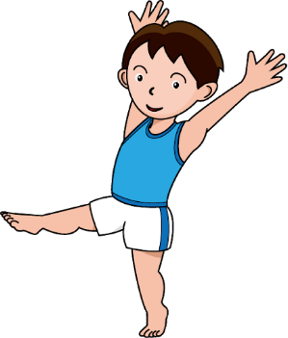
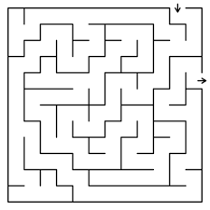
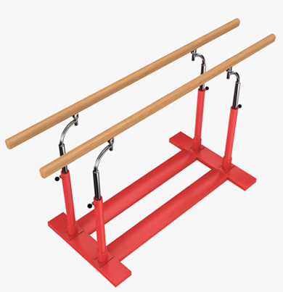
Maze Fun
Help Aiden find his way to the Parallel Bars for his first apparatus

Slide 8
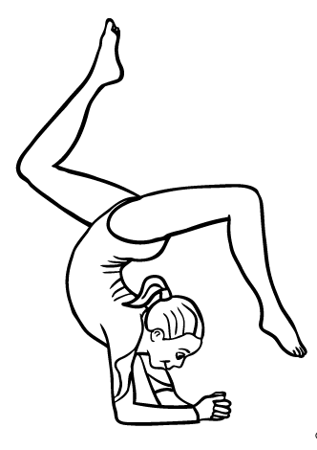
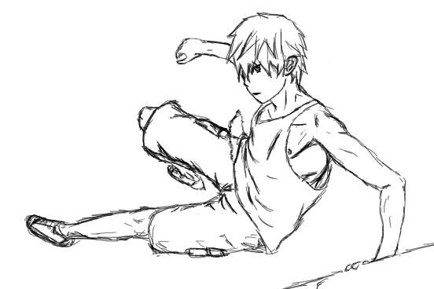
Colouring challenge!

Slide 9
Wordsearch Fun – Level 2
L | G | N | J | C | I | G | F | L | S | F | P | E | K | A | R | C | H | B | G
I | S | B | U | N | N | Y | H | O | P | Y | C | N | I | S | A | K | E | J | C
H | Q | A | B | F | S | B | E | M | I | H | A | N | D | S | T | A | N | D | Y
K | D | F | D | D | A | I | M | A | T | B | Q | I | F | B | L | O | A | T | L
J | I | P | B | P | I | K | E | P | G | M | B | A | C | K | F | L | I | P | S
B | S | B | A | O | Y | A | C | L | A | K | E | C | P | X | E | A | H | S | C
Q | H | E | P | R | O | U | N | D | O | F | F | E | F | B | I | B | T | H | K
A | H | T | D | D | S | D | J | C | S | M | H | B | Y | R | P | E | C | A | A
G | C | A | R | T | W | H | E | E | L | A | O | S | R | I | G | L | O | N | F
B | K | F | C | A | T | S | B | C | L | B | G | T | B | D | I | E | S | D | O
C | N | B | V | E | S | A | L | E | S | T | A | R | H | G | Q | M | F | S | A
A | E | D | J | S | H | M | A | D | J | N | S | A | U | E | A | E | E | P | C
N | T | S | B | S | B | G | S | A | R | B | I | D | P | B | Y | N | K | R | L
B | U | N | N | Y | H | O | P | H | E | K | B | D | E | A | I | T | V | I | N
O | C | Q | B | C | K | F | I | H | S | A | D | L | S | D | J | S | D | N | A
S | K | E | I | M | A | T | N | B | K | B | U | E | M | X | B | T | I | G | Z
A | J | B | P | E | M | B | L | E | I | O | J | N | A | K | G | A | F | L | O
M | U | F | A | R | B | K | C | F | R | O | G | B | A | L | A | N | C | E | T
L | M | D | C | I | R | C | L | E | U | P | S | F | E | R | A | Q | J | B | F
Q | P | R | U | T | F | D | B | N | U | I | A | N | K | B | T | L | L | H | R
CARTWHEEL
HANDSTAND
ELEMENTS
STAR
SEAT DROP
ARCH
CIRCLE UP
BUNNY HOP
STRADDLE
ROUNDOFF
BACKFLIP
DISH
BRIDGE
FROG BALANCE
SPIN
HANDSPRING
TUCK JUMP
PIKE

Slide 10
Crossword – Level 2
 |  |  |  |  |  |  |  | 1
 |  |  |  |  |  |  |  |  |  |  | 2
 |  |  |  |  |  |  |  |  |  |  |  |  | 4
 |  |  |  |  |  | 3
 |  |  | 6
 | 5
7
 |  |  |  |  |  |  |  |  |  |  | 9
 |  |  |  |  | 8
ACROSS:
Trampoline skill using your bottom
Front tumbling skill
Forwards or backwards floor skill
DOWN:
Round-off in the air
Cartwheel with no hands
Forwards or backwards, rotating in the air
Flexibility skill used throughout gymnastics
Backward tumble following a Round-off
Bars dismount
9. Apparatus 4" wide

Slide 11
Wordsearch Fun – Freestyle
D | W | S | A | F | E | T | Y | R | O | L | L | P | K | F | D | O | A | S | M
Q | W | P | A | H | L | I | A | Z | R | I | S | D | O | T | H | E | E | A | B
F | A | O | K | I | C | K | T | H | E | M | O | O | N | G | B | R | Z | K | S
E | L | H | M | T | N | B | X | N | U | L | K | T | G | A | I | N | E | R | D
T | L | Z | P | I | L | F | L | L | A | W | I | H | V | F | W | I | H | P | U
C | R | P | K | H | N | D | S | F | V | E | X | L | A | E | C | E | O | D | A
V | U | N | D | E | R | B | A | R | M | D | A | P | U | V | B | A | R | J | R
T | N | A | C | H | G | Q | G | L | T | I | M | N | L | B | L | P | I | Y | C
G | O | H | S | S | D | A | S | H | V | A | U | L | T | A | G | S | D | O | H
W | A | I | P | F | X | O | H | U | J | U | E | Y | V | I | T | J | B | W | N
L | H | I | E | N | A | S | U | D | N | D | C | O | R | K | S | C | R | E | W
A | E | Z | E | J | L | I | A | T | O | I | A | F | H | M | U | E | N | R | E
C | O | A | D | I | S | H | S | E | C | A | T | B | A | L | A | N | C | E | Z
H | N | D | V | I | C | V | H | S | A | A | G | M | P | I | R | Q | A | X | U
E | W | E | A | R | A | J | B | Y | L | A | Z | Y | V | A | U | L | T | K | C
I | G | L | U | A | F | L | G | Q | T | S | G | J | Y | B | E | N | L | M | H
B | G | F | L | Z | G | C | N | E | O | C | A | W | H | R | V | W | E | E | T
H | L | V | T | I | C | T | A | C | R | E | U | N | Q | A | F | S | A | S | A
K | D | U | H | W | E | Y | M | J | I | A | S | K | C | E | I | J | P | H | B
P | R | E | C | I | S | I | O | N | J | U | M | P | E | R | A | J | D | A | L
DASH VAULT
CORKSCREW
WALL RUN
TIC TAC
GAINER
LACHE
KONG VAULT
DISH
UNDERBAR
SAFETY ROLL
LAZY VAULT
SPEED VAULT
ARCH
CAT LEAP
KICK THE MOON
CAT BALANCE
WALLFLIP
PRECISION JUMP

Slide 12
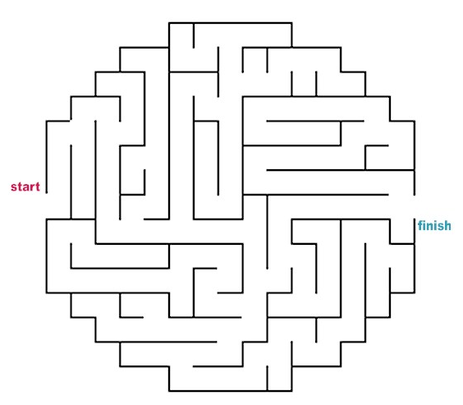

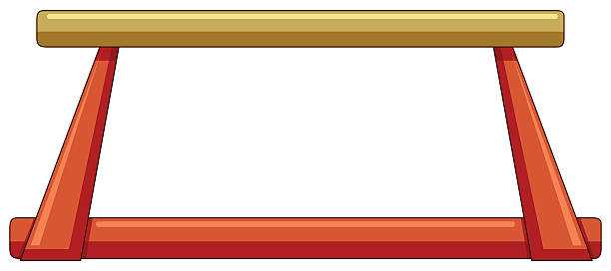
Maze Fun
Help Sophie find her way to the Beam

Slide 13
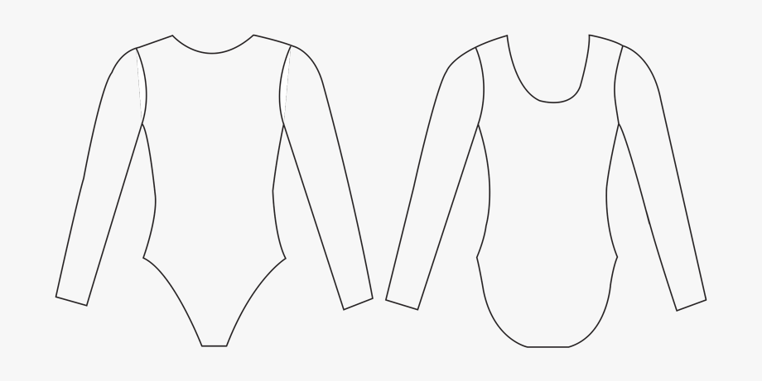
Design your own uniform

Slide 14
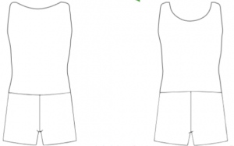
Design your own uniform

Slide 15
Wordsearch Fun – Level 3
A | J | C | O | S | E | L | I | B | E | N | O | M | I | S | I | A | B | F | A | U
Y | B | U | E | V | O | B | S | E | J | G | X | H | Q | E | V | B | Q | N | E | F
E | R | V | A | A | U | E | R | E | L | I | A | D | O | B | R | E | S | I | K | Y
I | I | N | E | L | L | I | E | K | I | M | C | J | A | I | N | T | E | L | B | R
N | N | F | S | L | D | P | I | W | A | D | M | K | Z | H | P | H | X | E | H | O
W | N | B | K | I | C | A | D | C | Y | L | L | N | B | G | U | T | N | W | Z | L
O | B | R | Y | O | N | Y | P | A | G | E | E | M | P | A | D | W | L | I | T | G
D | E | H | C | R | H | I | L | E | N | P | U | X | A | D | U | E | F | L | A | A
Y | V | F | V | A | W | E | U | O | A | I | K | T | E | N | T | D | E | S | J | K
K | A | D | B | K | G | N | I | Y | J | V | E | E | R | I | M | D | K | O | V | O
C | N | C | Y | R | B | S | F | U | J | K | T | L | L | W | N | L | O | N | L | R
E | O | I | E | A | T | A | C | X | C | Y | I | A | A | W | E | E | V | T | G | B
B | P | X | O | U | H | Q | P | O | S | H | S | H | Q | S | X | O | M | M | X | U
A | M | Y | T | I | N | K | L | E | R | T | I | B | K | D | I | B | R | O | W | T
E | G | A | T | M | N | T | C | W | I | A | X | M | S | F | J | L | T | E | V | A
C | N | A | S | T | I | A | L | I | U | K | I | N | U | Y | B | W | I | D | H | P
S | E | L | K | H | Z | B | M | A | P | C | B | H | E | R | S | F | A | V | B | P
A | I | U | W | E | S | A | L | G | U | O | D | Y | B | B | A | G | Y | R | A | H
M | T | X | K | D | Q | A | F | N | E | R | V | A | C | W | I | A | C | O | U | S
N | A | D | I | A | C | O | M | A | N | E | C | I | M | S | R | F | W | S | M | J
M | X | S | G | H | T | A | L | L | E | S | N | I | K | E | C | I | L | A | D | N
BRINN BEVAN
AURELIA DOBRE
SIMONE BILES
NILE WILSON
OLGA KORBUT
BRYONY PAGE
NADIA COMANECI
KOHEI UCHIMURA
NASTIA LIUKIN
BETH TWEDDLE
DANIELA SILIVAS
MAX WHITLOCK
ALEXEI NEMOV
ALICE KINSELLA
NELLIE KIM
BECKY DOWNIE
GABBY DOUGLAS
AMY TINKLER

Slide 16
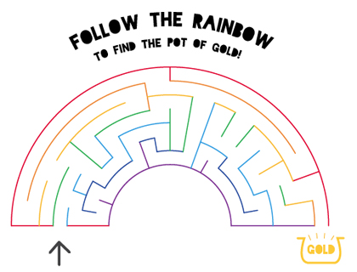
Maze Fun

Slide 17
Crossword – Freestyle
 |  |  |  |  |  |  | 3 |  |  | 4
 |  |  |  |  |  |  |  |  | 6
 |  | 1 |  |  | 2
 |  |  |  | 7
 |  |  |  |  |  |  |  | 5
8
 |  |  |  |  |  | 9
 |  |  |  |  |  |  |  | 10
DOWN:
Travelling using foot to foot technique
Traditional freestyle vault
Back somersault travelling forwards
Balance on just hands and feet
Acrobatic floor skill that spins
ACROSS:
Freestyle vault with hands touching at rear of vault
Bars skill
One footed somersault
Bars dismount
Somersault using vertical platform

Slide 18

Gymnastics Fact Finder Project
Use the internet to find out the nationality of the gymnast’s identified in the Level 3 Wordsearch
Then, research 3 interesting facts about each gymnast – you can do as many or as few as you like
Ask a grown-up to help you where needed
Use the following slides to log your facts and add a picture of each gymnast to each slide
You can then send them into us to display them in the gym on your return

Slide 19
BRINN BEVAN
Nationality:
1.
2.
3.

Slide 20
AURELIA DOBRE
Nationality:
1.
2.
3.

Slide 21
SIMONE BILES
Nationality:
1.
2.
3.

Slide 22
NILE WILSON
Nationality:
1.
2.
3.

Slide 23
OLGA KORBUT
Nationality:
1.
2.
3.

Slide 24
BRYONY PAGE
Nationality:
1.
2.
3.

Slide 25
NADIA COMANECI
Nationality:
1.
2.
3.

Slide 26
KOHEI UCHIMURA
Nationality:
1.
2.
3.

Slide 27
NASTIA LIUKIN
Nationality:
1.
2.
3.

Slide 28
BETH TWEDDLE
Nationality:
1.
2.
3.

Slide 29
DANIELA SILIVAS
Nationality:
1.
2.
3.

Slide 30
MAX WHITLOCK
Nationality:
1.
2.
3.

Slide 31
ALEXEI NEMOV
Nationality:
1.
2.
3.

Slide 32
ALICE KINSELLA
Nationality:
1.
2.
3.

Slide 33
NELLIE KIM
Nationality:
1.
2.
3.

Slide 34
BECKY DOWNIE
Nationality:
1.
2.
3.

Slide 35
GABBY DOUGLAS
Nationality:
1.
2.
3.

Slide 36
AMY TINKLER
Nationality:
1.
2.
3.

Slide 37


