Slide 1
Our Family Olympics
2020

Slide 2
Getting Started …..
Create your Olympics Banner to place up in the background
Use the following slides to prepare your banner
Print 5 of the Olympic rings to colour in (blue, red, black, yellow & green)
Print out and colour in the year of your Olympics “2020”
Change the Team name to something of your choice and colour it in – you can even change the fonts to something different
Colour in your Olympic Cauldron
Link your Olympic rings and place on your wall or fence and add the Olympic Cauldron, your Team name and “2020” to create your Olympics Banner

Slide 4
2020

Slide 5
Team Smith

Slide 6
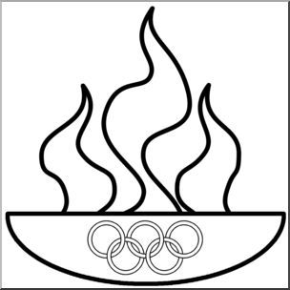

Slide 7
Create an Olympic Torch
You will need:
A sheet of paper or card or a paper plate
Scissors
Sellotape
Red/Yellow/Orange paper/tissue paper or coloured felt tip pens
Instructions:
Roll your sheet of paper/card/plate into a torch shape and use Sellotape to hold it in place.
You can colour or paint your torch if you wish
Create flames by either using coloured tissue paper cut and stuck to the inside of the top of the torch or colour in the flame templates and stick to the inside of your torch
Some ideas follow on the next slide

Slide 8
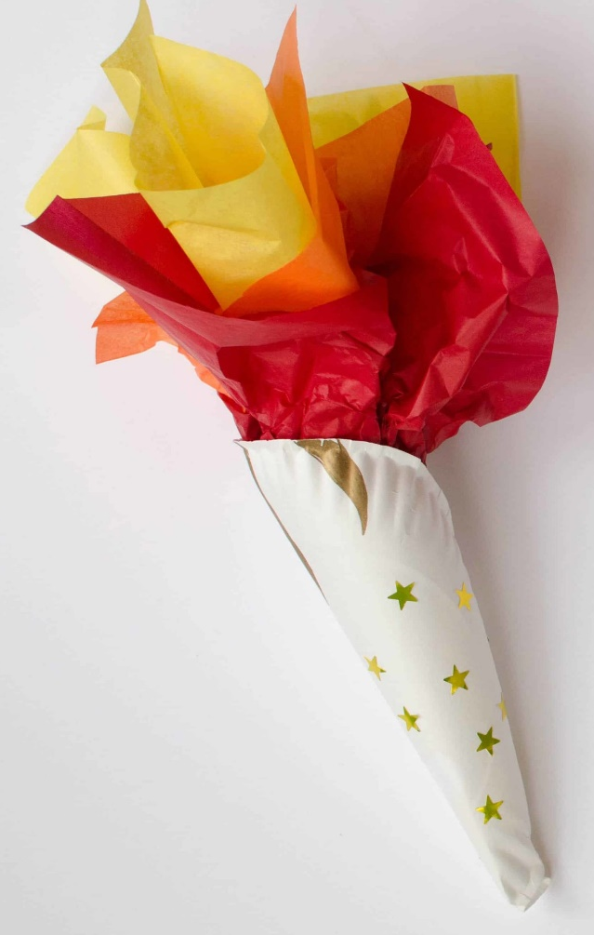
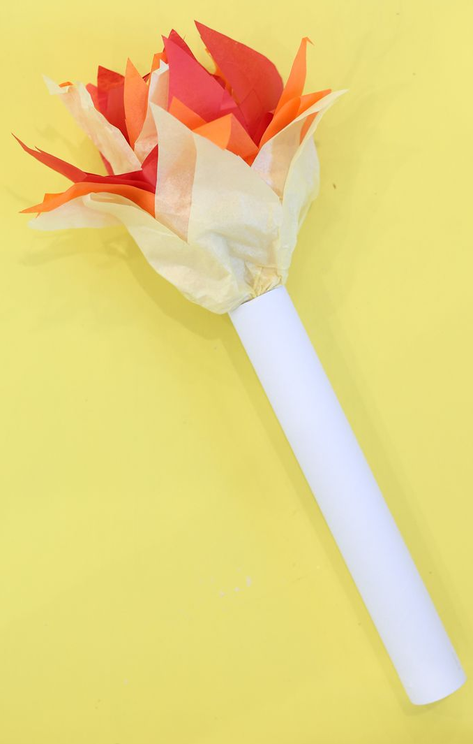
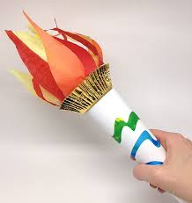

Slide 9
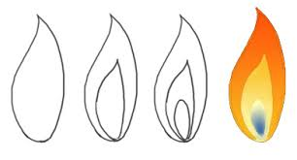
Flames to colour and cut out

Slide 10
Create your Olympic Medals
Use the following templates to print out and colour in or create your own medals
You can stick them onto cardboard and use string or ribbon to finish your medals
You could even decorate or bake biscuits to use as medals
Have a look at some of the examples on the following slide …

Slide 11
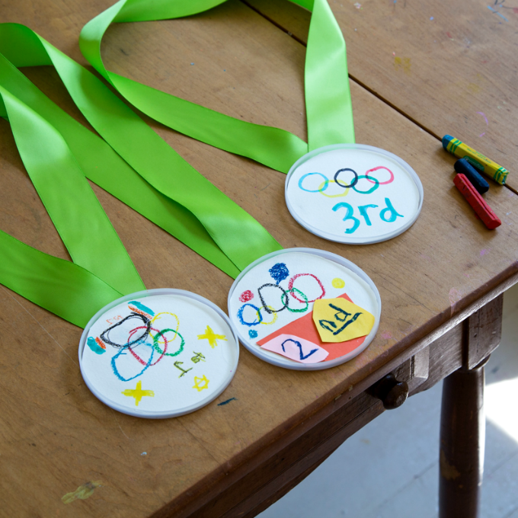
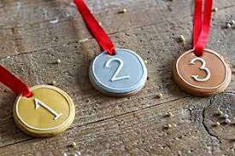

Slide 12
2020
2020
GOLD
SILVER
2020
BRONZE

Slide 13
2020
2020
1
2
2020
3

Slide 14
1st
2nd
3rd

Slide 15
GOLD
SILVER
BRONZE

Slide 16
2020
2020
1st
2nd
2020
3rd

Slide 17
2020
2020
GOLD
SILVER
2020
BRONZE

Slide 18
Choose a Country to represent
Pick a country for each of your teams to represent or create your own country
Create a flag for each of your teams. You can either print a ready-made flag, colour one in or create your own flag using the template provided
We have provided a few flags for you to colour in or print out but you can use the internet to find a different one or create your own flag using the guides at the end of the flags
You can Sellotape your flags to a straw or something similar to wave

Slide 19
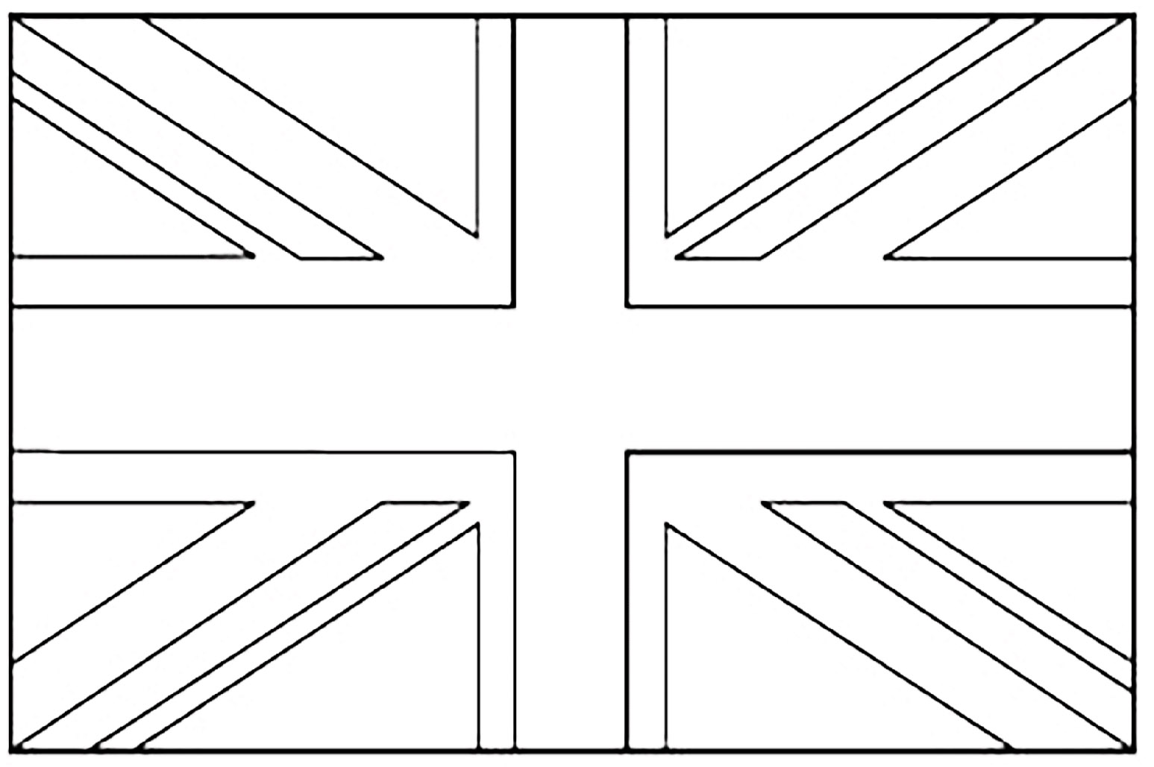
United Kingdom

Slide 20
United Kingdom

Slide 21
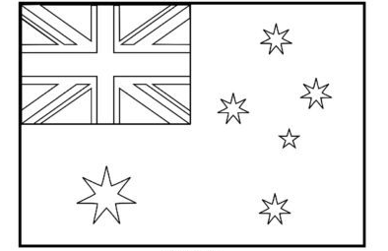
Australia

Slide 22
Australia

Slide 23
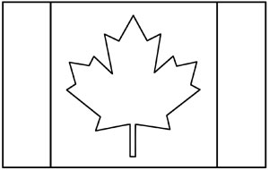
Canada

Slide 24
Canada

Slide 25
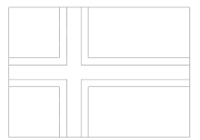
Iceland

Slide 26
Iceland

Slide 27
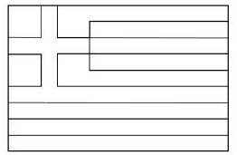
Greece

Slide 28
Greece

Slide 29
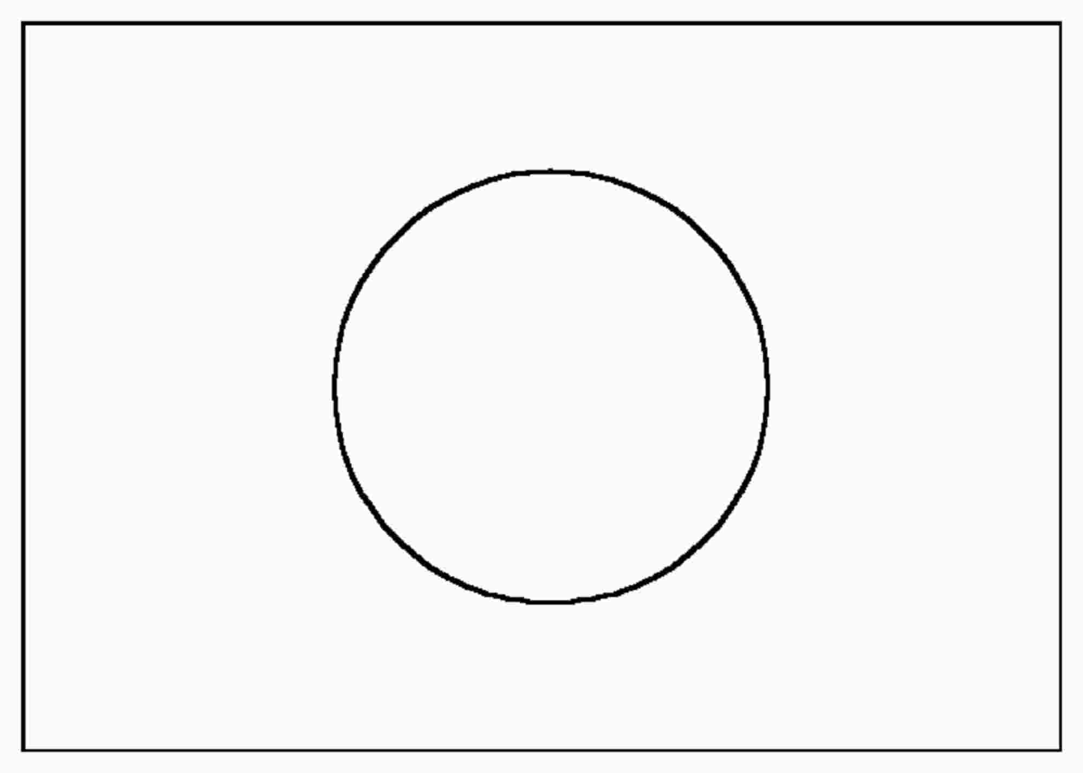
Japan

Slide 30
Japan

Slide 31
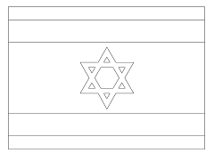
Israel

Slide 32
Israel

Slide 33
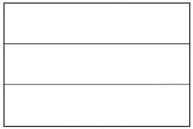
Germany

Slide 34
Germany

Slide 35
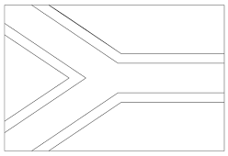
South Africa

Slide 36
South Africa

Slide 37
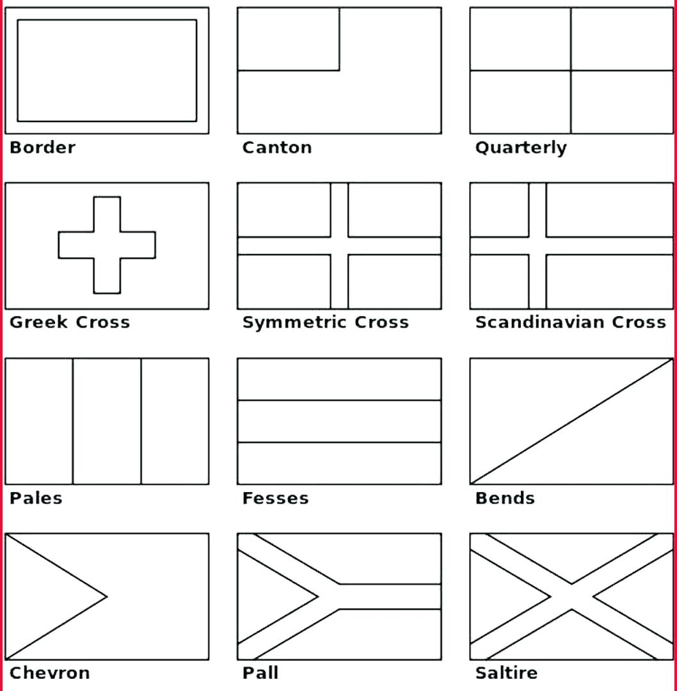
Create your own flag

Slide 38
Create your own flag

Slide 39
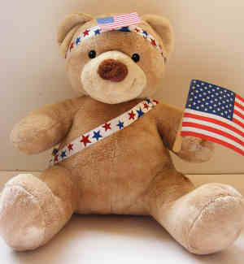
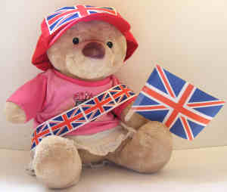
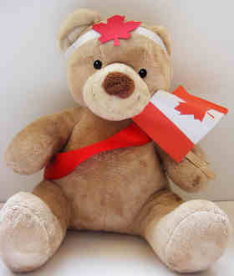
Gather your supporters
Assemble your audience by getting your teddies ready to cheer for their team!
You can use the flags and colour schemes to decorate them if you wish or just get them seated ready to cheer you all on ☺

Slide 40
Prepare your events
You will need:
Selection of small, medium books (at least a couple of hardback books)
Paper and scisssors
Cardboard
Ribbon and wooden spoon or medium sized ball
Stopwatch
10-12 plastic/paper cups – 2 different colours or differentiate to make 2 teams of 5-6 cups
10-12 cans (soft drinks or tins)
Soft toys
A couple of baskets or similar
4 buckets or containers for water (similar size)
Basketball or similar sized ball x 2
Pool Noodles / Paper Towel Rolls
Bean bags or small soft toys
Tape measure or measuring stick

Slide 41
Hold your Olympic Opening Ceremony
Place your banner and Olympic Cauldron over your Olympic Arena
Gather your supporters and line them up ready to receive their athletes
Assemble your athletes with their flags and/or mascots
Play some appropriate marching music
Nominate your flame bearer to lead the athletes and light the Olympic Cauldron
Let the Games begin …..

Slide 42
OLYMPIC EVENTS
Beam Exercise
Monster Jump
Floor Exercise
Cup Flips
Marathon
Rhythmic Gymnastics
Slalom Run
Basketball
Javelin Throw
Long Jump
Relay Race

Slide 43
EVENT INSTRUCTIONS – BEAM EXERCISE
Preparation:
Tape a line on the floor to make a “beam” or draw a beam on the pavement with some chalk. Make the beam as long as you like.
Gather your books and place at one end of your beam
Goal:
Balance as many books on your head as you can whilst walking along the “beam”. If you fall off the beam or drop a book, go back to the beginning. Points are awarded for getting all the way without falling off or dropping a book in one go:
1 book 1 point
2 books 3 points
3 books 5 points

Slide 44
EVENT INSTRUCTIONS – MONSTER JUMP
Preparation:
Print out 10 sheets of the Monster Feet and lay them out in a line with each pair facing a different direction. Alternatively you can draw monster feet on the pavement using chalk.
Goal:
Each person takes a turn and starts with both feet on the first pair of Monster Feet. Start the timer and jump to the next pair and so on until you reach the finish line.
Place participants in order of fastest time completed. If you miss the Monster Feet you must start again at the beginning!

Slide 45
MONSTER FEET

Slide 46
EVENT INSTRUCTIONS – FLOOR EXERCISE
Preparation:
Place several soft toys on the floor and sit just in front of them with your legs straight out in front touching the toys.
Lay down and place a basket a little way behind your head.
Goal:
Start the timer and as fast as you can pick up a soft toy with your feet and roll back to lift the toy above and behind your head and place it in your basket.
Continue for 1 minute and record how many you complete in this time.

Slide 47
EVENT INSTRUCTIONS – CUP FLIPS
Preparation:
Create a large Noughts & Crosses grid either using some cardboard placed on a table with masking tape to create a grid (see next slide) or place the masking tape grid directly on your table
Each team should have a different set of 5-6 cups. You can place stickers on them or decorate your cups to make them different for each team.
Goal:
One from each team starts together
Balance the bottom of one cup each on the edge of the table (half on, half off) and, together, try to flip the cup so it lands either way up (you choose)
As soon as the cup lands the correct way up you can place it on the grid – first one to get a row of 3 wins!
Keep going till all team members have had a chance to play.

Slide 48
CUP FLIPS
Use masking tape on either a table or on a large piece of cardboard taped to a table to create your Noughts & Crosses Grid

Slide 49
EVENT INSTRUCTIONS – MARATHON
Preparation:
None
Goal:
In pairs from each team one person lays down on their tummy on the floor while their partner stands to their side about midway down
Start the timer and one partner must jump over the partner on the floor who will then do a press-up to create a bridge. The jumper then crawls under the bridge to the other side where the bridge closes back to the floor again. Repeat as many times as you can in 1 minute.
Points awarded for how many complete circuits you make in 1 minute.

Slide 50
EVENT INSTRUCTIONS – RHYTHMIC GYMNASTICS
Preparation:
Either use a medium sized ball or create a Rhythmic Gymnastics ribbon by sellotaping some ribbon to the end of a wooden spoon
Goal:
Create and perform a rhythmic gymnastics floor routine. Each routine must include the following:
A jump from two feet to two feet
A leap from one foot to the other
A roll on the floor
A movement to show flexibility
A balance on one leg
Each element must be shown without dropping the ribbon or the ball. Try to create a starting position and an ending position. You can do your routine to music if you choose.

Slide 51
EVENT INSTRUCTIONS – SLALOM RUN
Preparation:
Lay out 10 tins/cans in a line on the floor leaving a gap of about 12 inches between each one. At one end of the line place a basket and at the other end place a selection of 5 soft toys or similar items.
Goal:
Starting at the basket end crawl as fast as you can on your hands and knees/feet over the tins without touching any of them and pick up a soft toy. Run back with your soft toy running in and out of each tin/can and place the toy in the basket. Repeat until all toys have been placed in the basket.
Place participants in order of time to complete.

Slide 52
EVENT INSTRUCTIONS – BASKETBALL
Preparation:
None
Goal:
Lay on your back with your knees bent to 90 degrees with feet raised a little higher.
Your teammate stands just in front of your feet holding the ball.
Gently drop the ball onto the feet of your partner and when it rolls down towards your knees catch the ball with your hands and throw back to your partner.
Do this as many times as you can in 1 minute. Use 2 balls if you’re fast enough!

Slide 53
EVENT INSTRUCTIONS – JAVELIN
Preparation:
None
Goal:
Javelin Toss using either a pool noodle or paper towel roll. Place participants in order of longest distance thrown

Slide 54
EVENT INSTRUCTIONS – LONG JUMP
Preparation:
Create a starting line either using chalk on the pavement or a skipping rope (or similar).
Goal:
Starting with feet together at the starting line, bend your knees and jump as far as you can. Measure the distance from the back of the heels to the starting line. Place participants in order of distance jumped.

Slide 55
EVENT INSTRUCTIONS – RELAY RACE ***OUTDOOR EVENT ***
Preparation:
Place a bucket full of water at your starting line and an empty bucket at the finish line. Gather one cup and a hard backed book or similar that you don’t mind getting wet for each team.
Goal:
From the start line fill up one cup of water from the bucket and balance it on your hardback book or alternative flat holder.
Run from the start line to the finish line without spilling your water and pour the water into the empty bucket.
Run back with your cup to your next team member who repeats.
Keep going until all the water is empty from your starting bucket.
Winning team has the most amount of water in the bucket at the end.

Slide 56
Score Sheet
Event | Name | Name | Name | Name
Beam Exercise
Monster Jump
Floor Exercise
Cup Flips
Marathon
Rhythmic Gymnastics
Slalom Run
Basketball
Javelin Throw
Long Jump
Relay Race

Slide 57
Medal Tally
Event | Gold | Silver | Bronze | Winning Team name
Beam Exercise
Monster Jump
Floor Exercise
Cup Flips
Marathon
Rhythmic Gymnastics
Slalom Run
Basketball
Javelin Throw
Long Jump
Relay Race

