Slide 1
My Gymnastics Activity Book 2
Your Name

Slide 2
My Daily Gymnastics Challenges
Challenge | Mon | Tues | Weds | Thurs | Fri | Sat | Sun
Week 1
Week 2
Week 3
Week 4
Week 5
Week 6
Follow us on social media to find our daily challenges

Slide 3
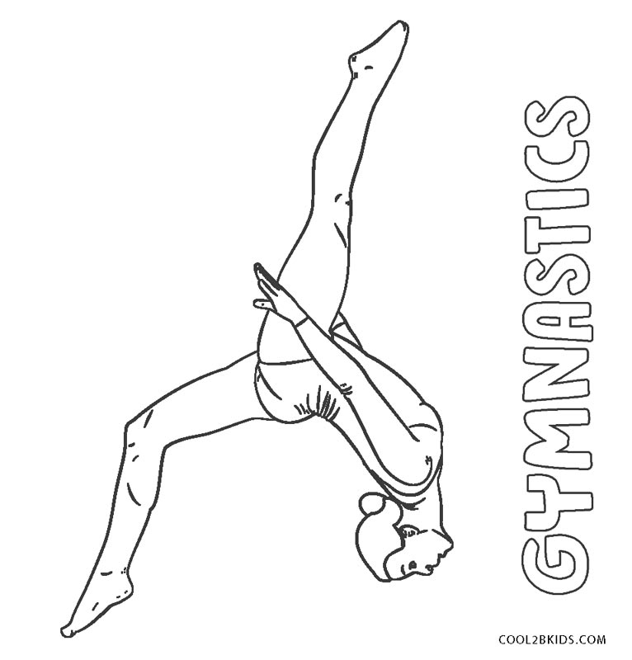
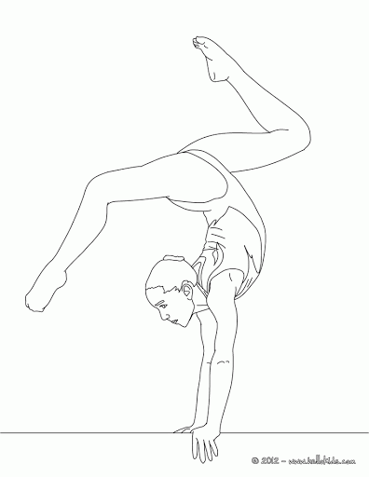
Colouring challenge!

Slide 4
Sudoku – Level 1
Every row, column and grid must contain the words shown below. See how many you can solve
DISH
ARCH
PIKE
I |  |  | D
 | D | I
 |  | S | H
S | H |  | I
 | C | A
 | A |  | R
A | R |  | C
C |  | R
 | P | I
 | K |  | E
P |  | K | I
K |  | E

Slide 5

Wordsearch Fun – Level 1
A | B | N | A | R | I | E | D | V | A | Y | J | B | C | K | E
X | E | F | P | L | F | S | S | L | A | M | G | P | S | I | H
I | J | S | T | R | A | D | D | L | E | N | E | V | S | M | N
C | K | V | W | E | I | U | G | A | K | O | T | B | P | K | U
L | A | F | O | Y | H | M | T | L | J | D | N | H | I | L | C
Z | G | Q | J | D | C | A | N | E | P | R | O | L | N | Y | I
B | T | J | U | M | P | A | O | W | A | D | B | U | F | E | T
S | N | F | S | R | I | F | I | S | Q | U | A | T | R | H | S
K | S | A | Q | E | K | L | J | E | D | G | M | I | B | N | F
M | H | Z | A | K | E | S | H | Z | A | U | L | E | A | P | F
X | A | G | T | D | H | N | E | W | C | T | A | D | F | R | L
B | P | L | B | O | U | N | C | E | X | B | N | O | L | E | I
F | E | U | O | R | J | H | P | Q | I | R | D | P | J | W | P
D | V | B | A | M | E | W | B | A | G | N | E | S | Q | A | K
O | C | P | K | G | I | R | E | C | L | Y | R | U | N | V | O
I | A | E | I | H | O | P | U | Q | E | K | T | N | O | D | M
JUMP
SPIN
LEAP
SQUAT
PIKE
FLIP
HOP
STRADDLE
BOUNCE
LAND
SHAPE
RUN

Slide 6
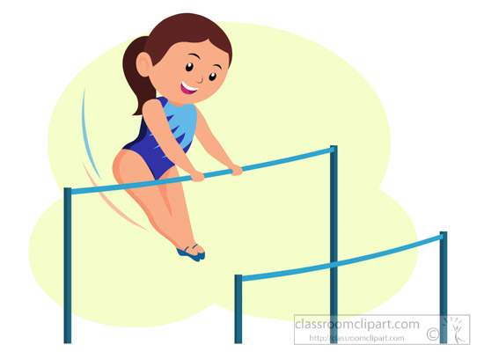
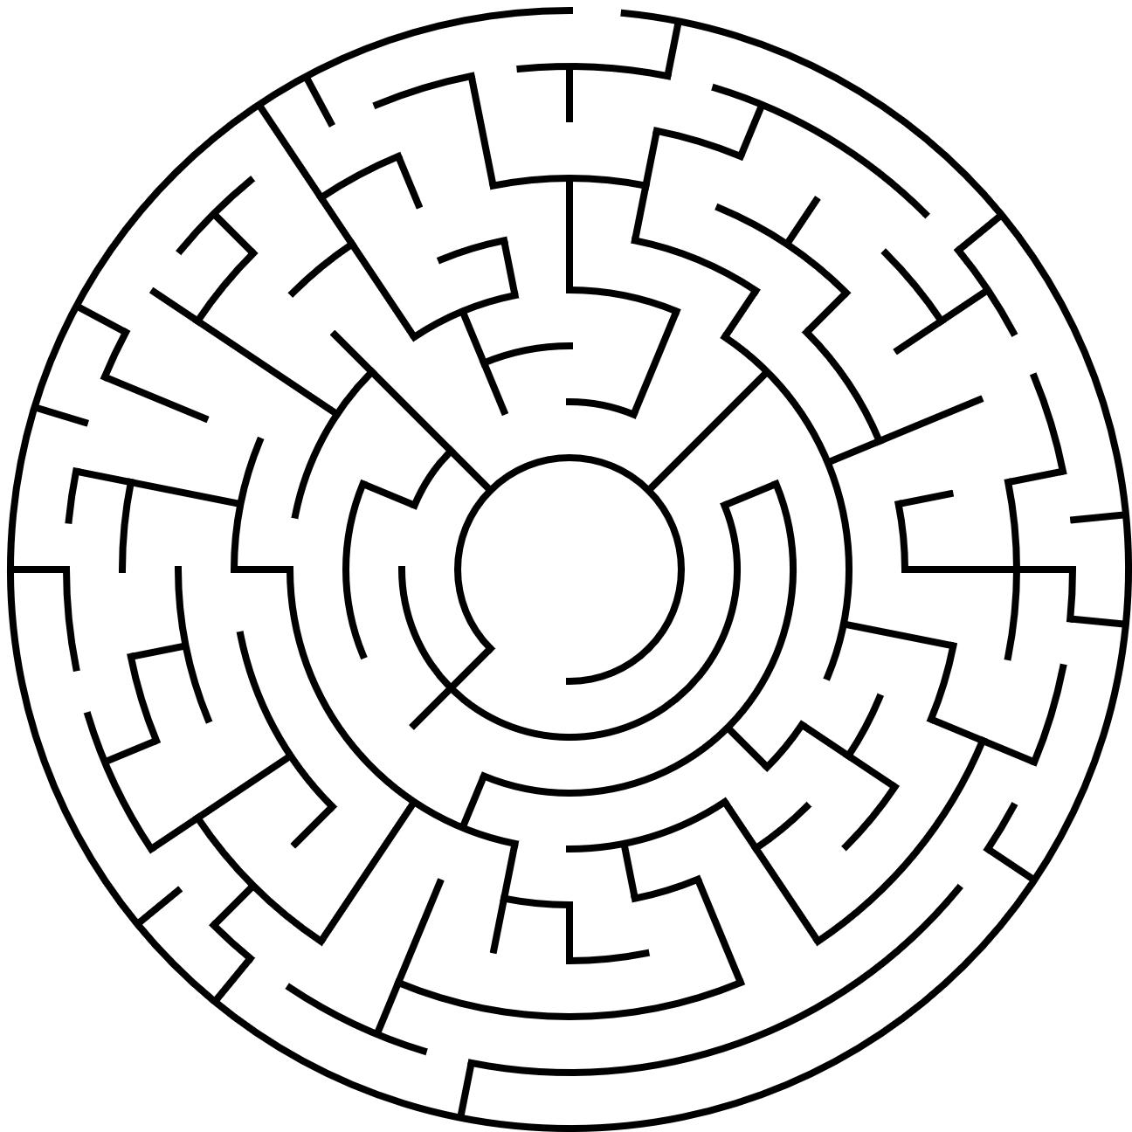
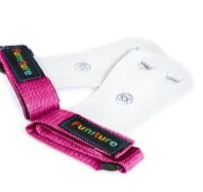
Maze Fun
Can you help Martha find her Handguards

Slide 7
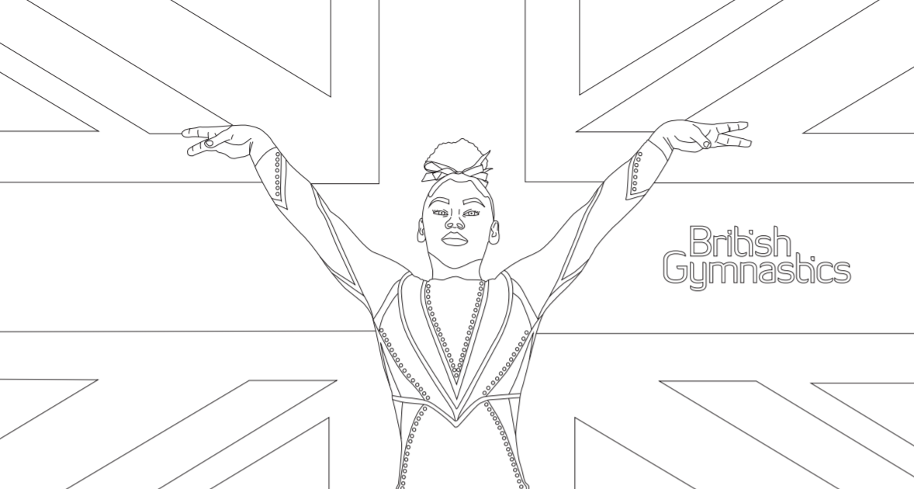
Colouring challenge!

Slide 8
Sodoku – Level 2
 |  | N |  |  |  | S
D | N |  |  |  |  |  | H | N
 | H |  | N | N | D |  | A
N |  |  | D | S |  |  |  | H
N | A | D |  | H |  | D | A | S
T |  |  |  | D | N |  |  | A
 | D |  | T | N | A |  | D
H | T |  |  |  |  |  | S | D
 |  | D |  |  |  | N
Every row, column and grid must contain the word “HANDSTAND”
Answers at the end of the booklet

Slide 9
Sodoku – Level 2 Freestyle
C |  | C |  | S | R
 |  |  |  |  |  |  | R | C
E |  | R | C |  | W | S | O
 |  |  | W |  | K |  |  | S
 | W | R |  | C | E | O
 |  | C | R |  |  | K
S |  | K |  | E | O
 |  | W |  |  | S |  |  | K
R |  |  |  |  | C |  |  | O
Every row, column and grid must contain the word “CORKSCREW”
Answers at the end of the booklet

Slide 10
Wordsearch Fun – Level 2
J | N | K | Q | L | F | W | O | M | R | E | E | D | V | B | S | O | W | N | M
T | Z | D | O | E | I | F | U | L | L | T | W | I | S | T | S | A | O | S | B
F | A | X | P | V | N | A | B | P | I | W | K | S | H | T | L | P | K | N | L
K | U | N | D | E | R | S | H | O | O | T | E | M | T | K | D | A | C | V | O
B | I | B | C | R | V | H | O | S | D | B | R | G | O | E | Y | N | A | E | C
A | R | P | F | O | G | E | W | M | H | Q | O | V | I | F | E | Q | L | S | K
C | D | A | W | J | D | Z | C | Y | E | A | E | U | A | T | J | A | E | O | T
K | S | P | R | I | N | G | B | O | A | R | D | E | E | C | I | Y | L | K | L
A | U | H | M | A | U | D | S | G | X | A | S | Q | G | Y | T | N | C | S | H
W | L | I | F | K | B | Y | C | O | C | R | P | A | N | A | I | Y | R | I | C
A | B | O | G | R | N | E | L | I | T | B | X | H | U | S | C | G | I | T | E
Y | F | N | T | C | G | Q | S | W | J | E | C | L | G | L | K | R | C | B | X
S | B | D | A | A | P | N | E | Q | A | K | B | G | N | A | T | H | P | V | L
E | Z | I | S | E | I | V | N | H | U | S | O | H | I | U | O | P | I | K | S
G | A | M | C | T | R | K | F | A | G | E | P | U | R | J | C | Z | H | S | A
P | I | R | O | U | E | T | T | E | O | I | O | A | P | X | K | O | K | H | E
N | E | D | R | B | A | N | Y | R | A | W | E | I | S | B | L | M | C | I | V
W | O | L | F | J | U | M | P | I | L | F | C | U | Y | R | G | E | A | P | F
M | A | L | H | Q | F | R | O | A | P | V | A | U | L | T | T | P | B | R | A
H | T | K | E | U | C | H | A | L | K | O | W | D | F | Y | P | M | W | G | S
BLOCK
LEVER
BACK HIP CIRCLE
WALKOVER
SOMERSAULT
PIROUETTE
SPRINGBOARD
BACKAWAY
TINSICA
AERIAL
CHALK
TICKTOCK
FLYSPRING
WOLF JUMP
VAULT
ARABESQUE
UNDERSHOOT
FULL TWIST

Slide 11
Wordsearch Fun – Freestyle
D | E | A | C | T | D | J | G | N | O | K | E | L | B | U | O | D | A | N | C
E | T | R | U | G | E | A | B | M | I | L | C | E | P | O | R | T | B | E | U
L | E | S | E | S | A | I | C | K | T | A | V | F | U | I | W | E | M | I | N
Y | R | G | Q | V | L | E | D | P | M | B | E | S | J | S | K | D | R | D | D
T | R | I | P | L | E | K | O | N | G | R | K | A | I | W | Y | A | E | V | E
S | J | Q | G | Y | T | R | X | H | W | C | L | G | F | I | J | P | H | K | R
E | S | F | R | O | N | T | S | U | P | P | O | R | T | N | D | B | R | T | S
E | H | E | W | M | I | N | O | E | H | B | E | L | N | G | F | E | U | A | H
R | M | P | B | J | P | N | I | O | V | Z | U | G | C | S | V | W | O | Z | O
F | A | H | T | O | S | D | H | R | M | A | X | I | M | O | E | O | K | H | O
C | R | J | W | I | Q | T | U | K | S | I | U | V | L | I | U | B | R | S | T
Y | B | E | I | O | G | D | E | R | T | L | S | L | F | L | A | W | A | G | P
D | A | W | S | A | K | C | E | P | B | A | U | Q | T | E | V | D | P | T | I
U | C | D | T | B | R | M | J | L | E | P | W | C | N | K | H | A | I | A | Y
B | K | B | D | I | O | W | N | H | K | A | S | J | A | A | S | E | Q | L | B
P | A | L | M | S | P | I | N | C | V | F | S | T | N | E | M | E | L | E | G
S | W | A | E | P | F | X | A | T | O | A | Y | H | C | E | I | A | H | Y | I
I | A | L | K | N | D | B | U | T | T | E | R | F | L | Y | K | I | C | K | T
W | Y | A | E | B | S | A | Z | E | D | O | N | I | S | L | P | D | U | F | A
H | A | O | J | T | H | R | M | A | V | S | I | D | E | F | L | I | P | R | C
DOUBLE KONG
PALM SPIN
BACKAWAY
BUTTERFLY KICK
PARKOUR
SIDE FLIP
REVERSE VAULT
SWINGS
ROPE CLIMB
SOMERSAULT
FRONT SUPPORT
UNDERSHOOT
TRIPLE KONG
B TWIST
BACK PULLOVER
FREESTYLE
J STEP
ELEMENTS

Slide 12
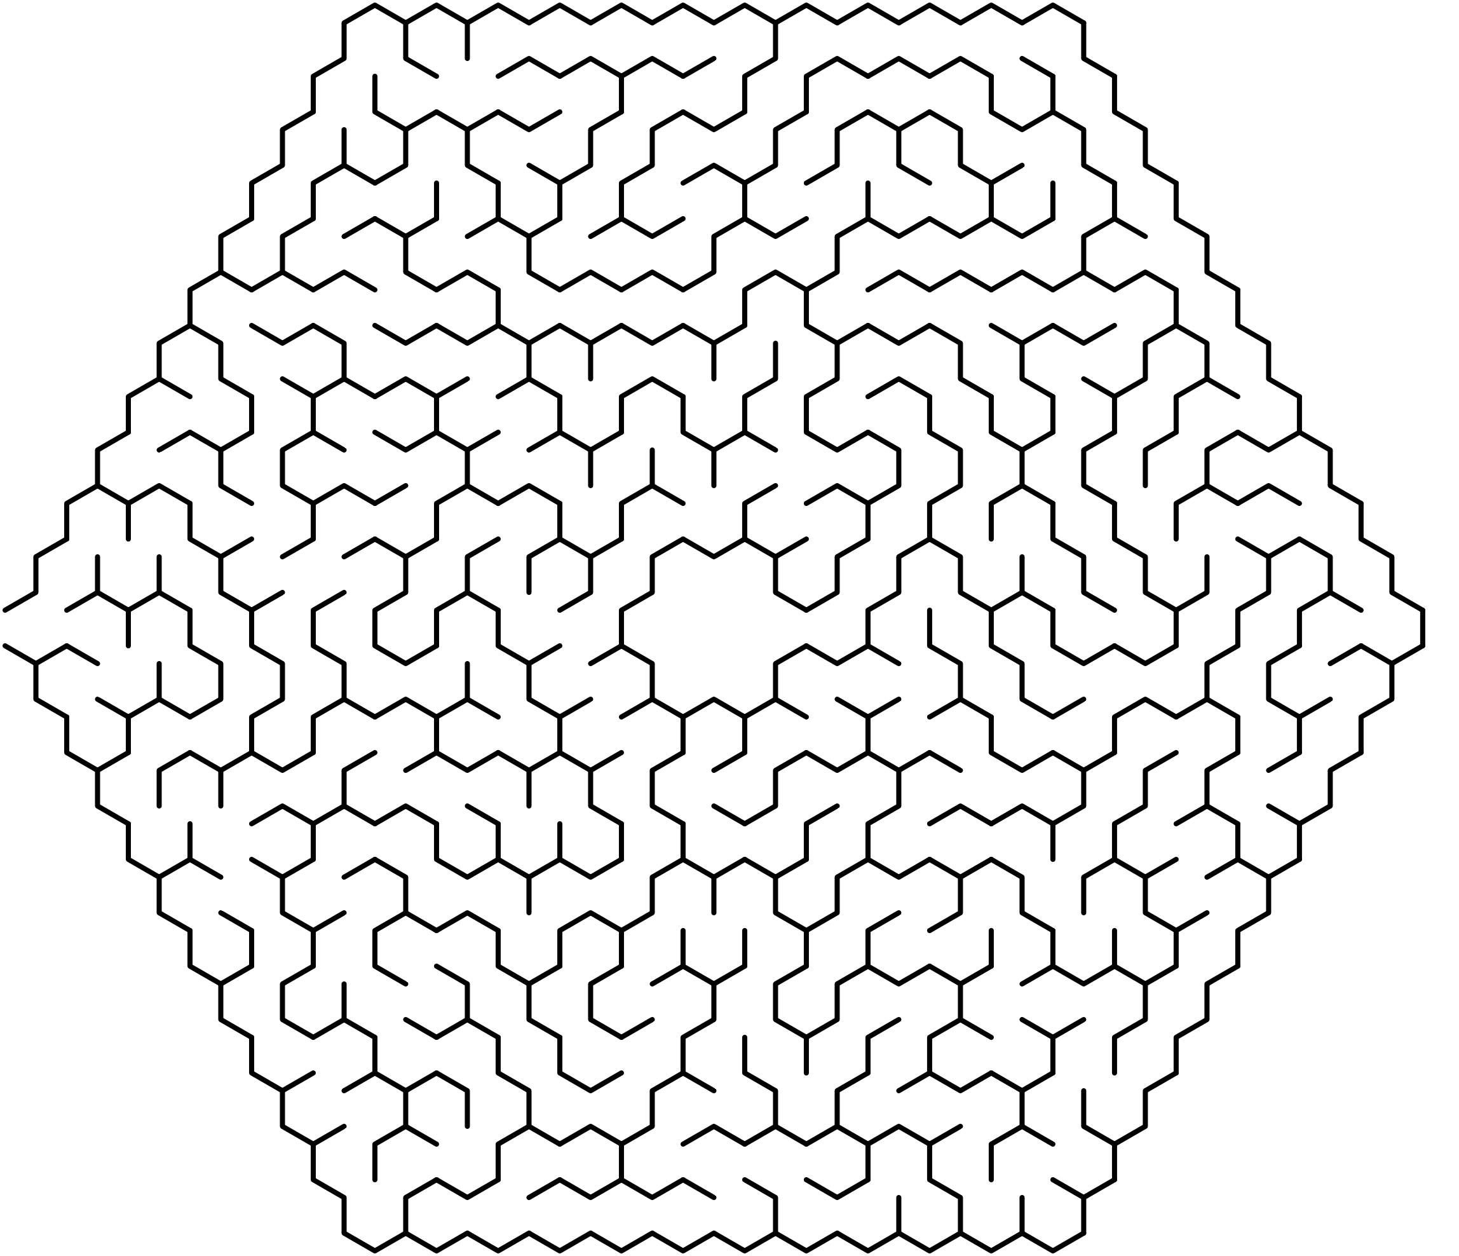
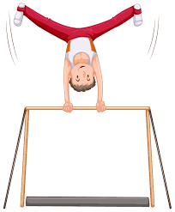

Maze Fun
Help Sam to find his water bottle

Slide 13
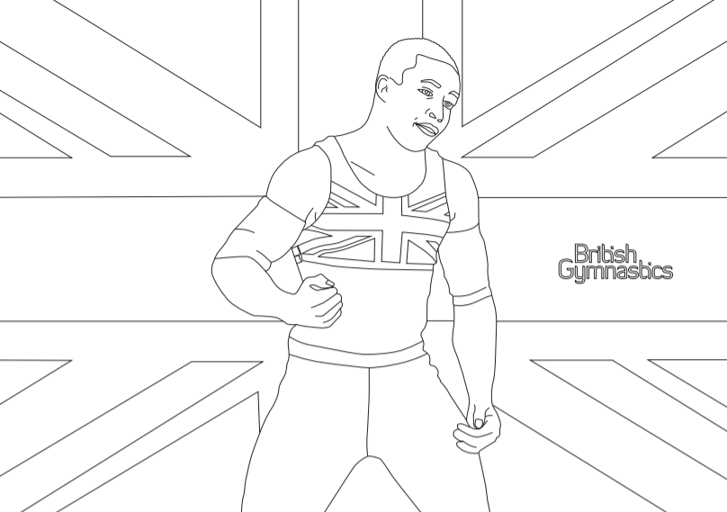
Colouring Challenge!

Slide 14

Colouring fun!

Slide 15

Colouring fun!

Slide 16

Gymnastics Fact Finder Project
Use the internet to find out the following information about the gymnastics skills shown below. Find out:
Which gymnast they are named after
What year the skill was created and on what apparatus
Then, see if you can describe the skill in your own words
Skills: Tsukahara Yurchenko
Popa Onodi
Healy Turn Shushunova
Amanar Korbut flip
Use the following sheets to record your answers

Slide 17
TSUKAHARA
Gymnast Full Name:
Date Skill Created:
Apparatus performed on:
Skill Description:

Slide 18
YURCHENKO
Gymnast Full Name:
Date Skill Created:
Apparatus performed on:
Skill Description:

Slide 19
POPA
Gymnast Full Name:
Date Skill Created:
Apparatus performed on:
Skill Description:

Slide 20
ONODI
Gymnast Full Name:
Date Skill Created:
Apparatus performed on:
Skill Description:

Slide 21
HEALY TURN
Gymnast Full Name:
Date Skill Created:
Apparatus performed on:
Skill Description:

Slide 22
SHUSHUNOVA
Gymnast Full Name:
Date Skill Created:
Apparatus performed on:
Skill Description:

Slide 23
AMANAR
Gymnast Full Name:
Date Skill Created:
Apparatus performed on:
Skill Description:

Slide 24
KORBUT FLIP
Gymnast Full Name:
Date Skill Created:
Apparatus performed on:
Skill Description:

Slide 25
Sudoku Answers
Level 1 - DISH
Level 1 - ARCH
Level 1 - PIKE
I | S | H | D
H | D | I | S
D | I | S | H
S | H | D | I
R | C | A | H
H | A | C | R
A | R | H | C
C | H | R | A
E | P | I | K
I | K | P | E
P | E | K | I
K | I | E | P
Level 2 - HANDSTAND
Level 2 - CORKSCREW
D | A | N | A | T | H | S | N | D
D | N | T | S | A | D | A | H | N
A | H | S | N | N | D | D | A | T
N | D | A | D | S | A | T | N | H
N | A | D | N | H | T | D | A | S
T | S | H | A | D | N | N | D | A
S | D | A | T | N | A | H | D | N
H | T | N | D | A | N | A | S | D
A | N | D | H | D | S | N | T | A
C | O | C | E | S | R | W | K | R
W | K | S | O | C | R | E | R | C
E | R | R | C | K | W | S | O | C
C | E | O | W | R | K | C | R | S
K | W | R | S | C | E | O | C | R
R | S | C | R | O | C | K | W | E
S | R | K | R | E | O | C | C | W
O | C | W | C | R | S | R | E | K
R | C | E | K | W | C | R | S | O

Slide 26


